Slide 1
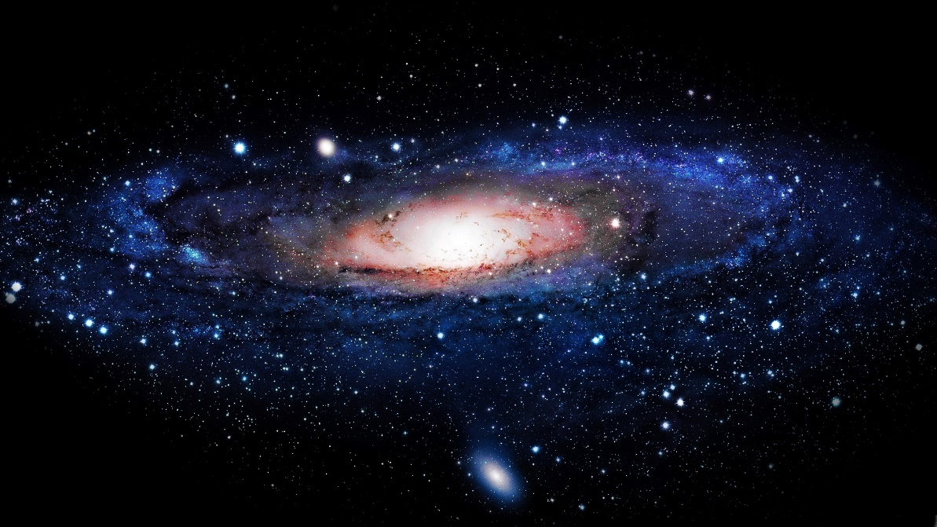

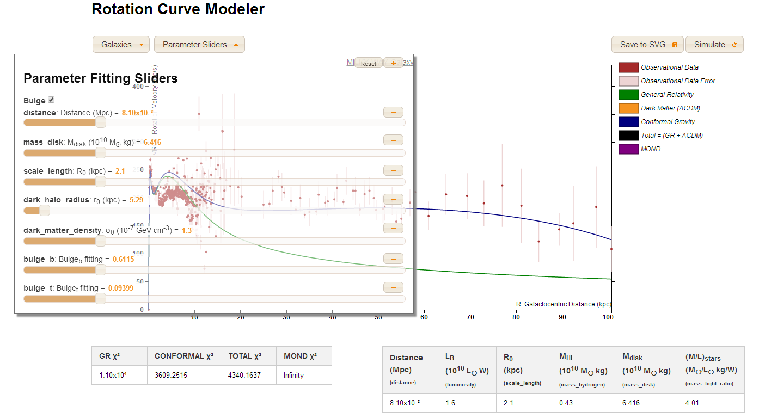
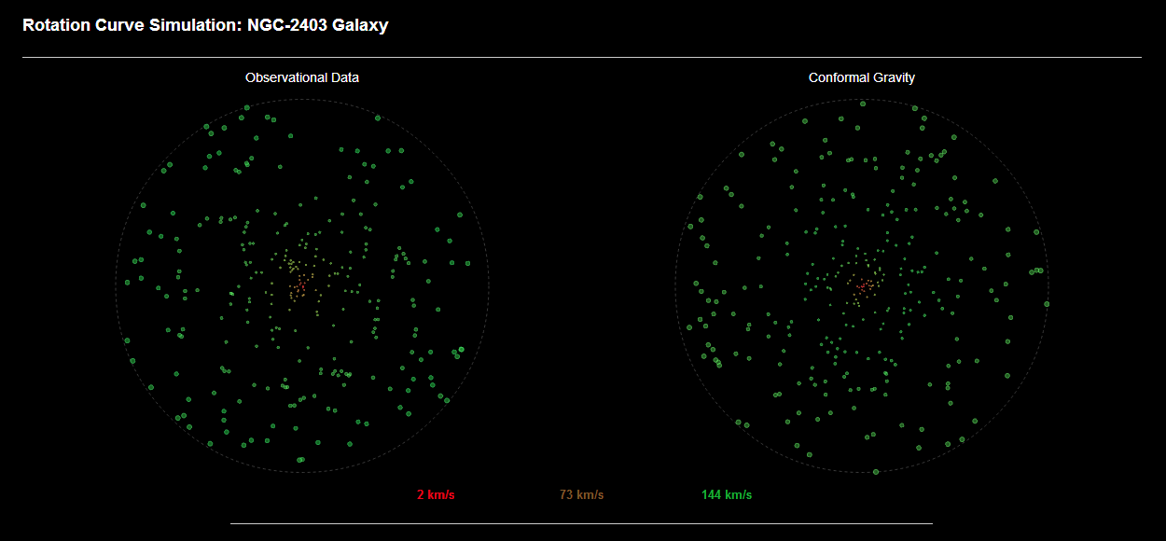
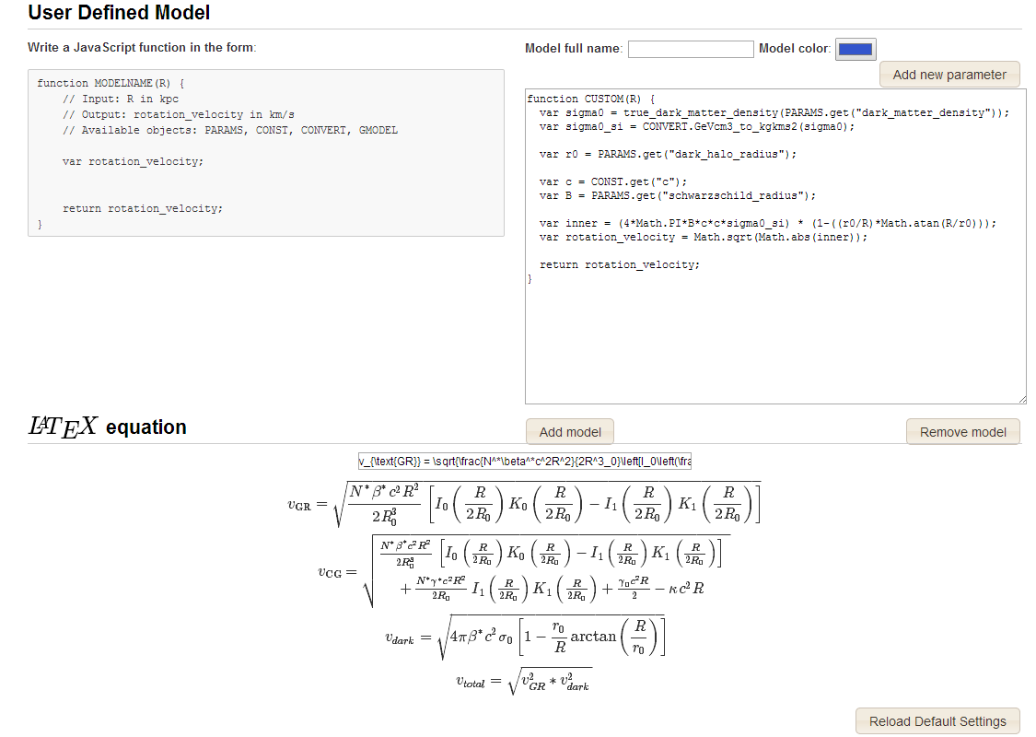
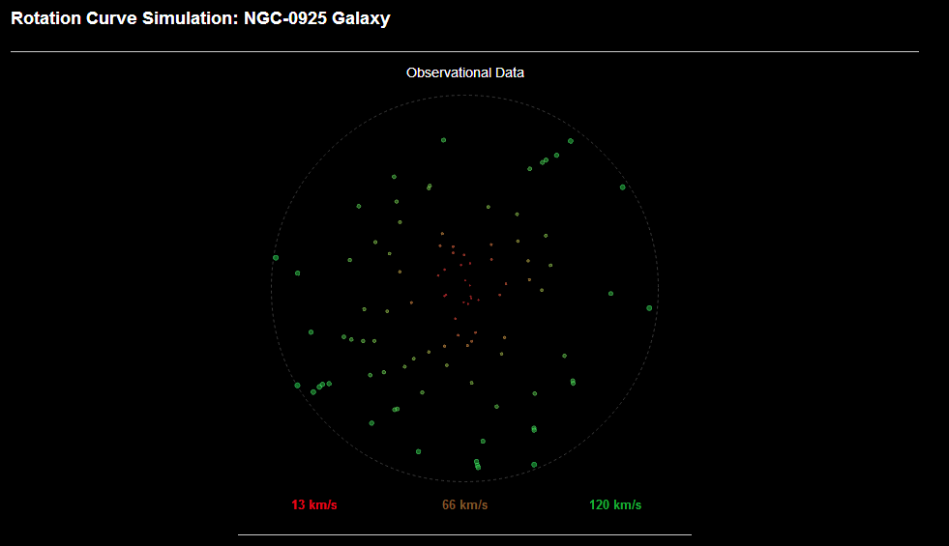
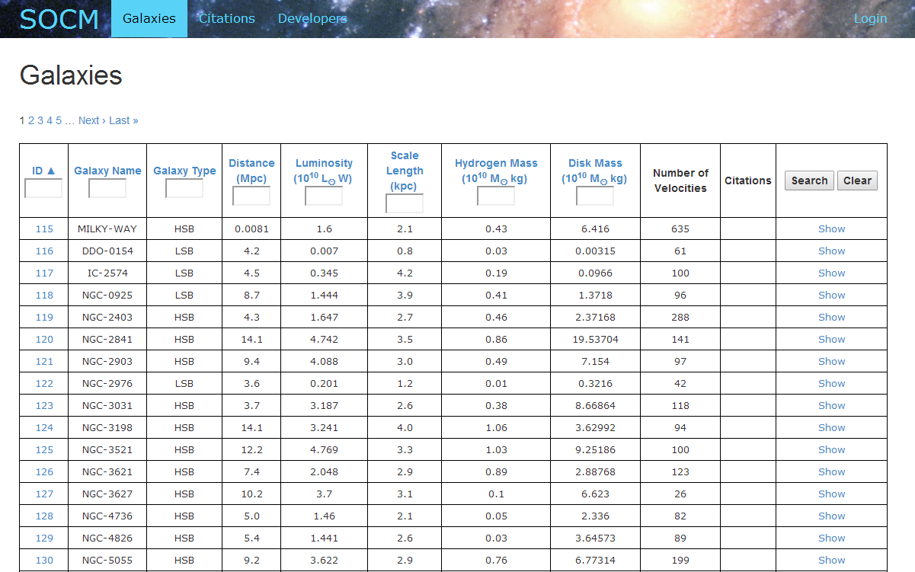
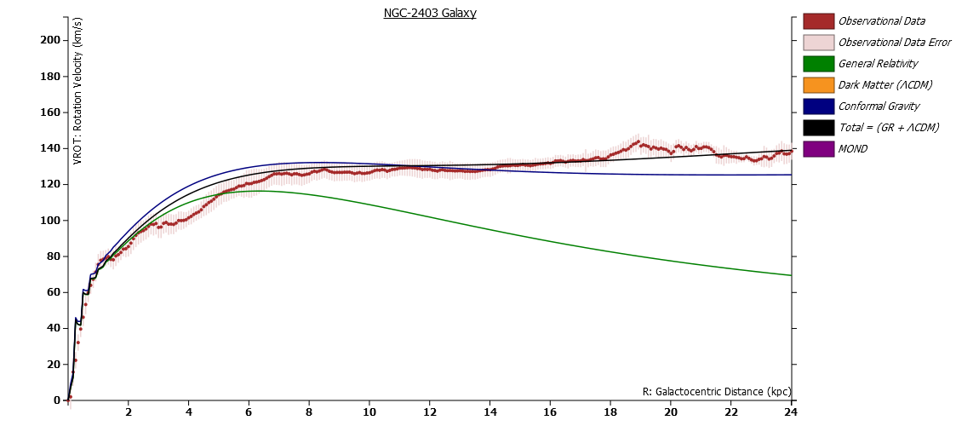
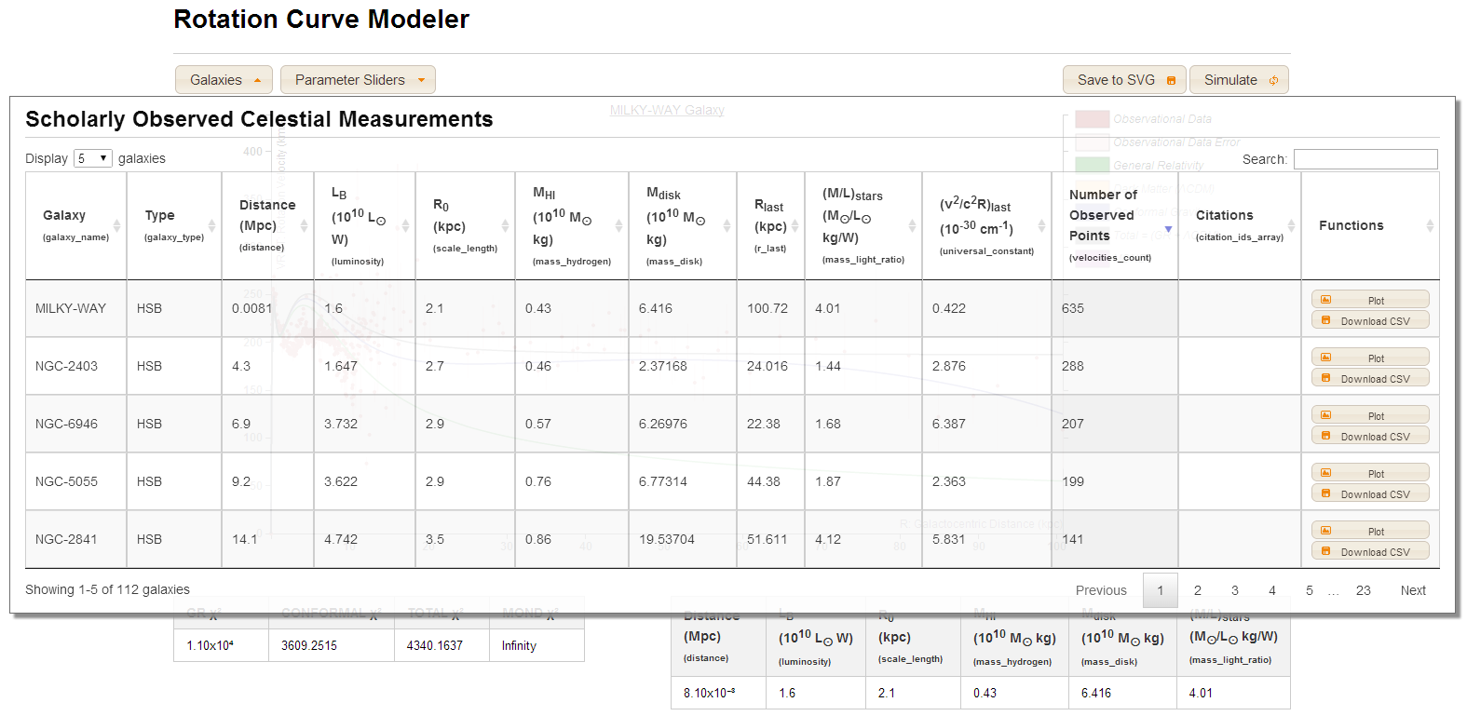
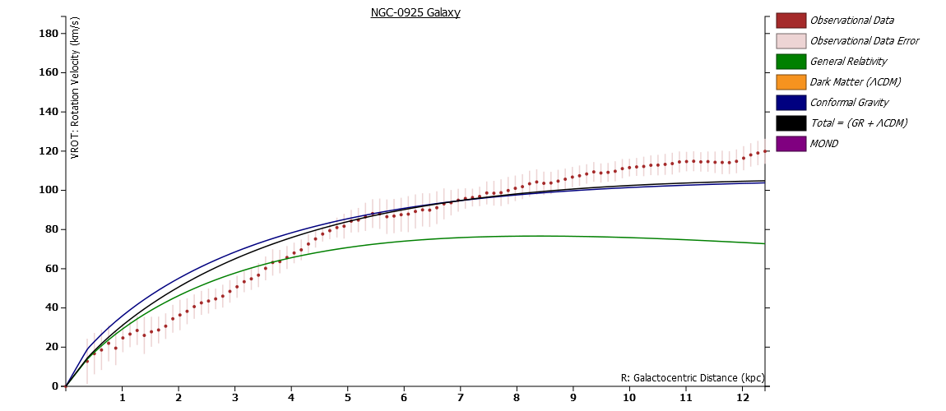
Rotation Curve Modeler & Scholarly Observed Celestial Measurements
For Arbitrary Galaxies
Robert Moss, Alex Clement, Patrick McGee, David Miller
with Professor James G. O’Brien, Lisa MacLean, and Mohammed Anwaruddin
Wentworth Institute of Technology | College of Engineering & Technology, Department of Computer Science & Networking
Introduction
Design
Rotation Curve Modeler
Rotation Curve Simulation
Astrophysicists need to model galaxies in programs like MATLAB or Mathematica, but there doesn't exist a singular tool to expedite this process in a universal format. Additionally, scholars must sift through peer-reviewed articles and gather galactic data one-by-one. This astronomical project intends to solve both of these problems by providing a space to generalize the work being done on galaxy research and provide one central repository of galactic parameters and observed velocity data for researchers. The website will consist of two major components: a galactic database (SOCM) and a galaxy modeler (RoCM).
Scholarly Observed Celestial Measurements (SOCM) serves as both a central database and API (Application Programming Interface) for researchers and programmers alike. SOCM includes galactic data collected on 112 galaxies, including the peer-reviewed measurements of stars contained therein. Users may submit new measurements to the SOCM administrator for approval. Programmers may pull from the SOCM API for any application they so desire.
The Rotation Curve Modeler (RoCM) serves as a tool to model the rotation of star clusters around the center of a galaxy. It’s purpose is to test all existing galactic models against the observational data for that specified galaxy. With observable data as the input (via SOCM), any arbitrary galaxy can be imported into the tool. The tool will plot observational data and multiple galactic models together as a graph, and enables users to import their own galactic models to test against existing theories. Parameter value sliders allow users to control free fitting parameters within their models with real-time visual feedback in the generated graph. Users may also generate a Rotation Curve Simulation (RoCS) to view their models against the data in two-dimensional rendering.
SOCM was built as a Ruby on Rails application with a PostgreSQL relational database and Twitter bootstrap for webpage views. The website consists of a landing page, pages for the galaxies, citations, and developer information, as well as pages for administrative functions.
The galaxies page consists of a paginated table containing the relevant higher-level information of galaxies, including their relative distance from our sun, luminosity, scale radius, mass of the disk, and more. Selecting one of these tables allows users to view the collected velocity measurements of stars for this galaxy, including respective distances from the center of the galaxy, the observed rotation velocity, and the calculated errors of these measurements. The citations page lists the papers from which these measurements are referenced.
RoCM and RoCS utilize the API provided by SOCM, querying for these high-level galaxy parameters and the galaxies’ constituent velocity measurements. Responses from the API come in the form of JSON (JavaScript Object Notation) objects, which can be parsed and utilized for application purposes.
RoCS provides a way to visualize the spin of the galaxy in question. The user can simulate either just the observational data, or a specified model against the data. The color scale represent the relative minimum and maximum velocity for the stars around the center of the galaxy. The scale helps recognize when the rotation curve simulation of a model doesn’t match up with the observational data (see the RoCS webpage for the animation of the full rotation simulation).
SOCM Galactic Database
Example Rotation Curves
Implementation
Conclusions
Accessing SOCM Data from RoCM
RoCM was also built as a Ruby on Rails application, along with a number of JavaScript libraries and our SOCM application as its database. The single-page website consists of the following: quick-reference table of SOCM (to select galaxies to plot), a table of sliders to manipulate values calculated from galactic models (for parameter fitting purposes), a rotation velocity over galactocentric distance graph to plot models against collected data, a button to save the graph as an SVG (Scalable Vector Graphic), a button to send the selected model to RoCS, a section for users to import their own models to use on the graph, and a section for users to import their models in LaTeX format. These tools all contribute to the powerful functionality we’ve provided in RoCM.
Much of the heavy-lifting on the site is performed by D3, a JavaScript library for “manipulating documents based on data.” ^{[1]} Our application uses asynchronous JavaScript calls (or AJAX calls) to pull data from SOCM. The D3 library then helps us translate and manipulate that data to create the rich graphs and tables provided in RoCM.
This project was a success thanks to the mind of Dr. James G. O’Brien. His work on the rotation curve problem and conformal gravity helped influence the outcome of the project. The hope is astronomers will upload observed galaxy data to SOCM and astrophysicists will use RoCM to testing existing and future galactic models to finally understand the dynamics of these giant collection of stars.
We are pleased to announce that SOCM is open to the public at socm.heroku.com, where users can now view our database of collected measurements and developers may use our API endpoints to use in their own endeavors. RoCM is hosted at rotationcurve.heroku.com and will be shortly moved to rotationcurve.wit.edu / rotationcurve.org. Each project is a contribution to the open source community and can be found here: https://github.com/RoCMSOCM
Bostock, Mike; “Data-Driven Documents”; Last updated: 2013; Last visisted: July 28, 2014; http://d3js.org/

